Slide 1
日期: 天气:
五月十八日
Objectives:
新單字 New words
句型练习: 有/沒有
Have/has/had sentence practice

Slide 2
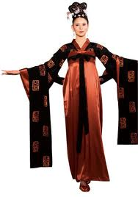
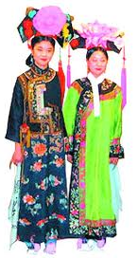
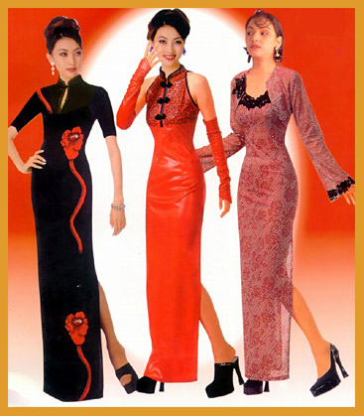
Chinese traditional clothes
Táng Dynasty
618-907 AD
Qīng Dynasty
1636-1912
Qípao

Slide 3
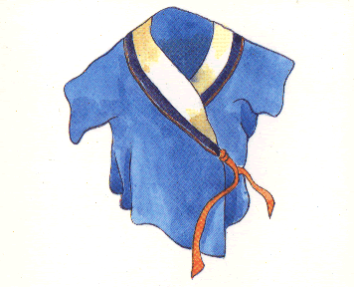
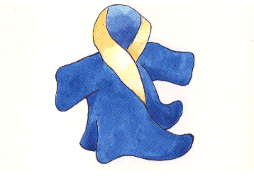
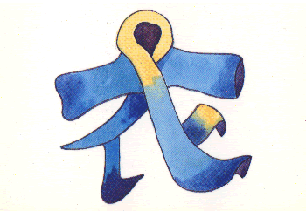
衣
yī
cloth

Slide 4
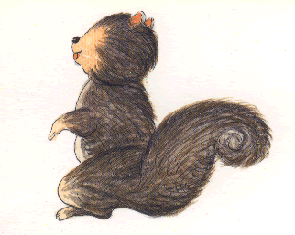
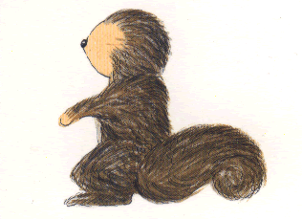
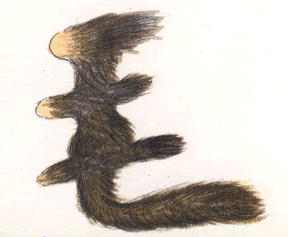
毛
máo
hairy

Slide 5
毛衣
máo yī
sweater

Slide 6
风衣
fēng yī
Windproof jacket

Slide 7
雨衣
yǔ yī
rain coat

Slide 8
雪衣
xuě yī
snow coat

Slide 9
大衣
dà yī
big coat

Slide 10
Homework Due date: 25th May Friday
Copy the vocabulary. Each vocabulary for 3 times.
Example：
风衣 风 衣 风衣 fēng yī， wind proof jacket
Vocabulary: 衣，大衣，雨衣，雪衣，風衣，毛衣

